Slide 1

Agentic AI Life Sciences Commercial
Capgemini POV
April 2025

Slide 2
PROACTIVE PATIENT INTERVENTIONS

Slide 3
Patient Services Optimization: Exploring data-driven patient journeys and providing actionable insights to address withdrawal rates and time to therapy
Every point in reduction of withdrawal rates represents an opportunity of $8M in additional revenue for one mid-sized LS company
Teams typically conduct analyses via time-consuming, ad-hoc manual queries leaving many questions remain unanswered
Existing process maps do not provide sufficient level of granularity and/or visibility required to determine outliers, insights, and actions
Reporting outputs are predefined, limiting the ability to quickly deep dive into nuanced business questions
BUSINESS PROBLEM
Withdrawal
Time to Therapy
PAP Effectiveness
What are the common pathways that lead to withdrawal?
Which HCP offices are the outliers?
Which patients/patient-types are most likely to withdraw?
What is the threshold of # of days where patients have a 50% likelihood of dropping out?
What causes long pending times prior to therapy initiation?
Which patients are most likely to experience longer patient journeys? What attributes are associated with these patients?
Which payer / plans result in the fastest TATs? Slowest? Why?
Is a PAP Program appropriate? Would it result in
What leading indicators determine why patients are more likely to result in PAP?
Which patients are likely to be candidates to convert from PAP to paid? Less likely? What attributes are associated with these patients?
BUISNESS QUESTIONS ANSWERED
VALUE ADDED
Accelerate time to therapy; decrease abandonment; increase paid scripts
Help identify high-risk HCPs and optimize call order, frequency, and messaging
Escalate appropriate intervention points with HCPs of high-risk patients
Identify and support patients that need additional communication and education
INITIAL
TIMELINE
Week 0-2 Visualize Patient Journey
Week 3-8 Similarity Analysis, Cluster Analysis, & Risk Rate
Week 9-12 Initial Next Best Actions Model

Slide 4
Our Innovation COE will guide Ipsen’s adoption of Gen AI-driven Use Cases
Distribution Channel
Data Sources
Gen AI Use Cases
3PL
Sales, Returns, Chargebacks, Inventory
Somatuline
e.g., Contract Attrition Predictive Modeling
Targeted account portfolio contracting strategy to preserve sales
Channel Partner Performance Reporting
Longitudinal Patient Journeys
Copay Optimization
SP, Payor & Provider Benchmarking for Patient Initiation and Adherence KPIs
Actionable Insights for Improved Patient and HCP Personalization, Engagement
Payor, Provider & KOL Influence Mapping, Spillover
Social Determinants of Health
FLW &
SD
EDI 867 - Sales
EDI 852 - Inventory
Onivyde
e.g., Patient Services HUB & HCP Targeted Interventions
Status, Dispense, Demo,
Inventory, & Enhanced Services
Accelerated TTF and reduced denials with gen AI-driven interventions
Patient
Data Sources
SP
Co-Pay
Enrollment, Utilization, & Claims
Dysport
e.g., Patient Identification & Engagement for Aesthetics
Lab
Genetic Testing Results
Target aesthetic use to drive increased sales momentum in US
Hub
Patient Enrollment & Status
Claims
Patient Financial Information
Bylvay
e.g., HCP Awareness & Education, Patient Advocacy & Personalization
Personalized rare disease engagement and advocacy strategy
EMR
Patient Dx & Px History
Web / App
Patient Activity

Slide 5
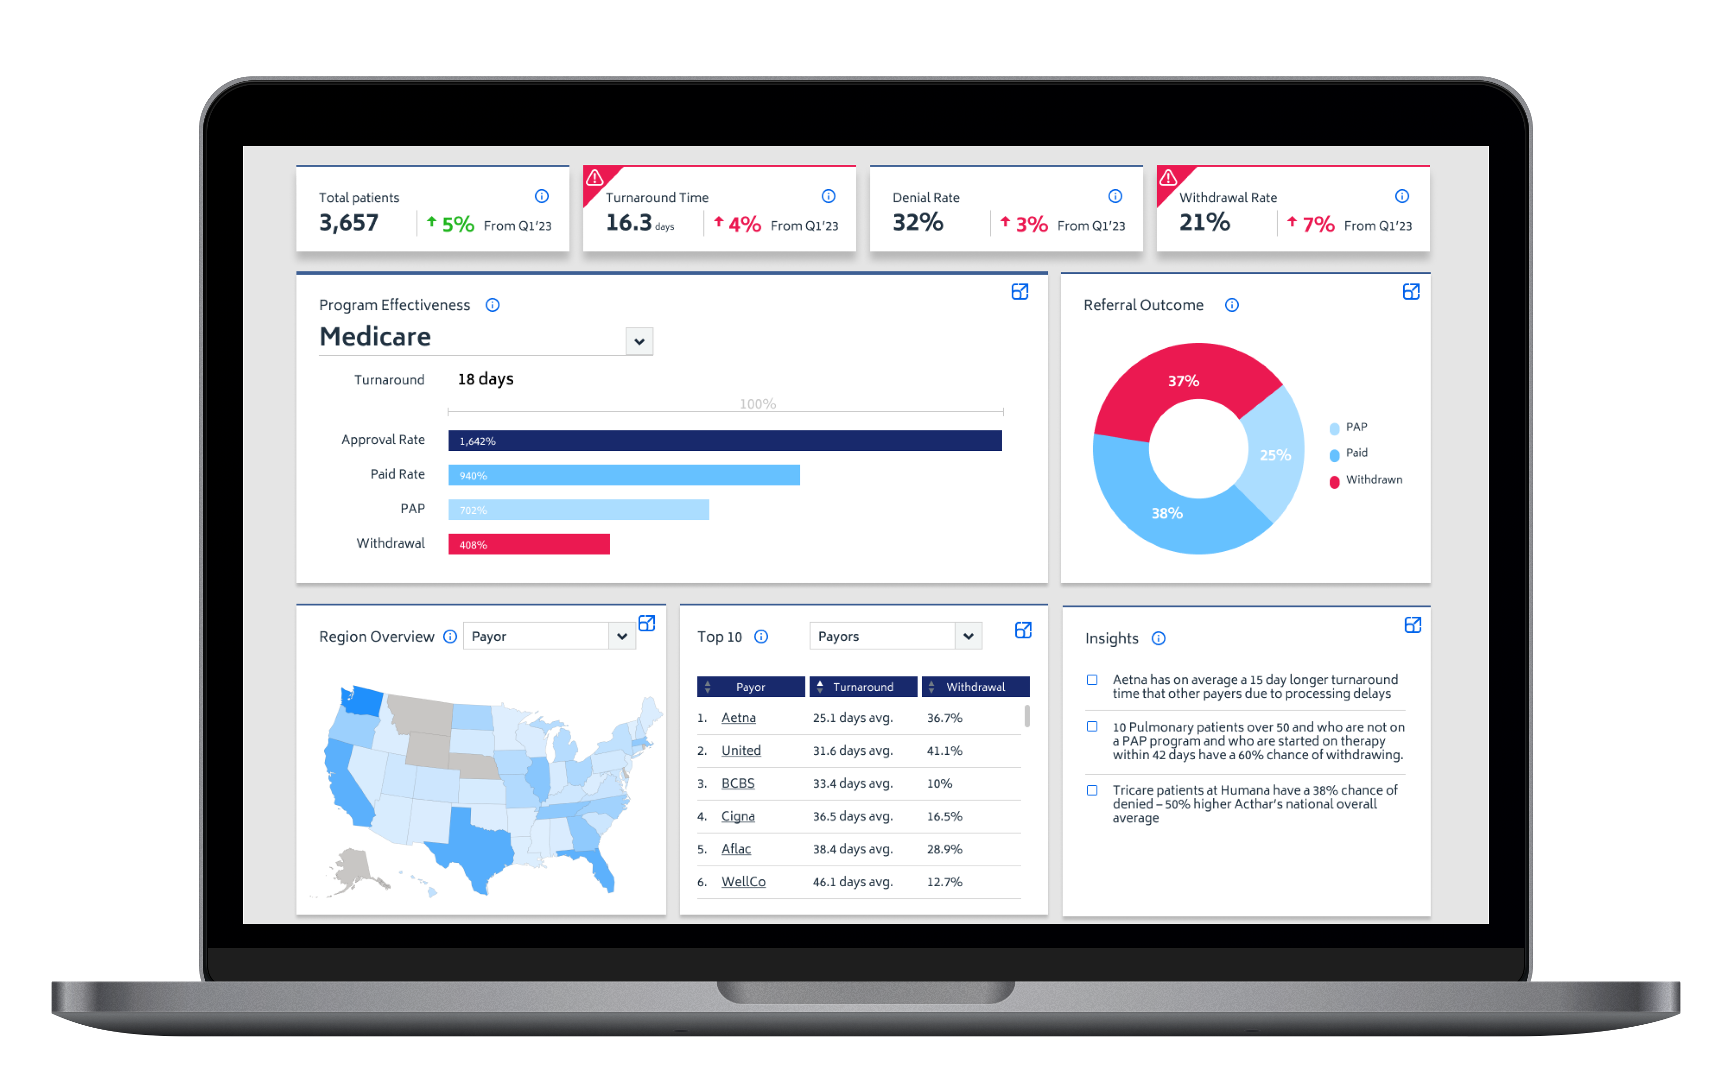
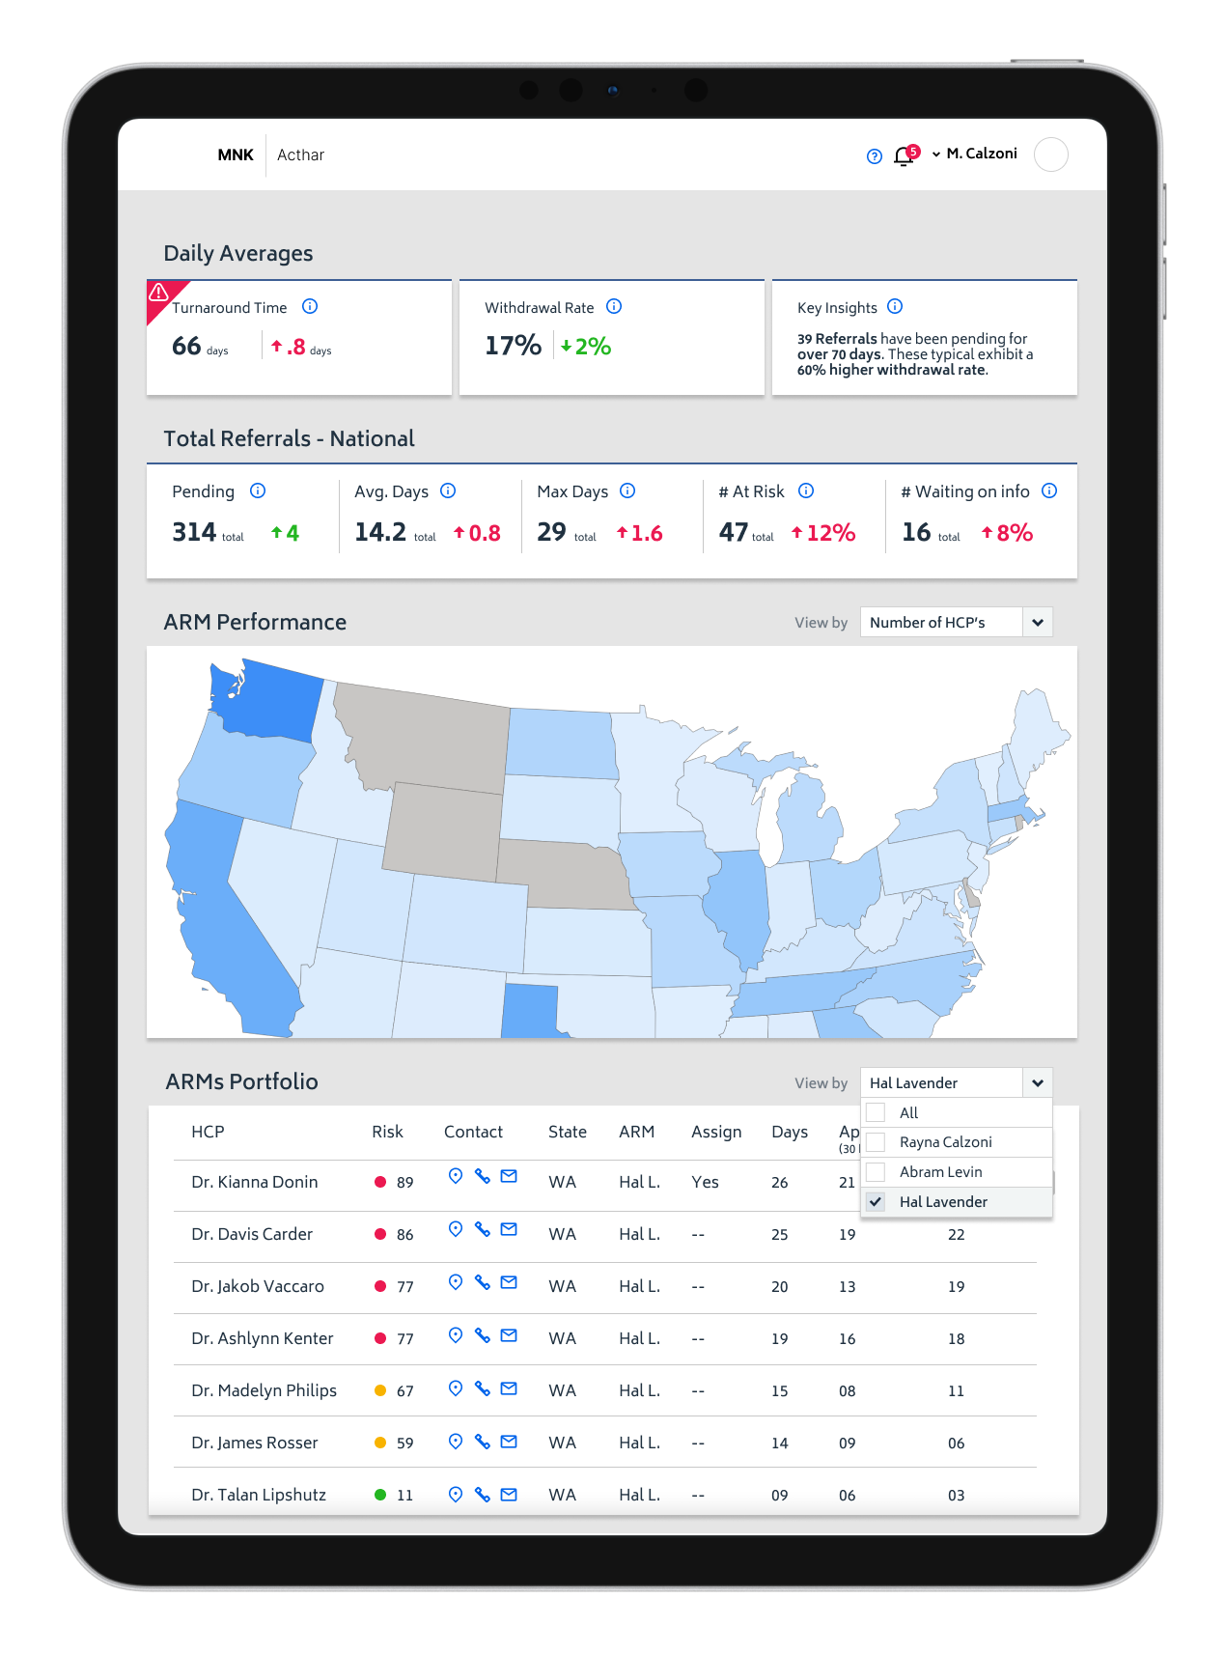

Proactively identify patients at risk of delays in prescription approval
Use AI to proactively identify patients who are at risk of not getting their prescriptions approved in a timely manner.
To assess HCP, patient, and payor data to find intervention opportunities facilitating a more successful patient journey between prescription and pickup
Patient Journey
Rx
Rx written
Rx fulfilled
Rx
Rx
Rx
At Risk
Payor
Denied
Rx
At Risk
Rx
Rx
Rx
Rx
At Risk
Patient
Withdrawn
Rx
Managers oversee program effectiveness and regional case management of ARMs
ARMs are notified about at-risk scenarios so they can assist before it is too late
What if you could…
improve the scripts that result in sales increase by
reduce the average patient time to therapy by
25%
30%
For a specialty Pharma, we found that for every 1% increase in the number of scripts that result
in sales, they can generate an incremental $8-10M.

Slide 6
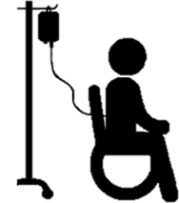




Patient Journey Overview SUPPORTED BY CAPGEMINI
Identify Key Milestones/Obstacles in Patient Approval Process
Each patient journey is unique. The metric calculations and analytics your brand relies on to measure performance and improve patient outcomes must reflect your brand’s unique patient journey at every step.
Missing information
Denied – not eligible
Patient declined
Waiting on shipment decision
Patient discontinued
Expired
Non-compliance
Enrollment
Shipment Approved
Shipped
PAP/BRIDGE
triage
refer
Enrollment
Benefits Investigation
Prior Authorization/
Appeal
Approved
Hub
Missing information
Waiting on patient
Waiting on HCP
Verification restrictions
Coverage
Medical or Pharmacy Benefits
Denied
Missing documentation
Waiting on payer
Waiting on HCP
PA denied
PA appeal denied
Denied
Patient
Prescriber
Enrollment
Benefits Investigation
Prior Authorization/
Appeal
Approved
refer
Specialty
Pharmacy
Triage
LEGEND
Process
Bottlenecks
NOTE* The above diagram is a representative depiction of sample journeys
THE OPPORTUNITY: DATA DRIVEN ENGAGEMENT OF HCPS & PATIENTS

Slide 7

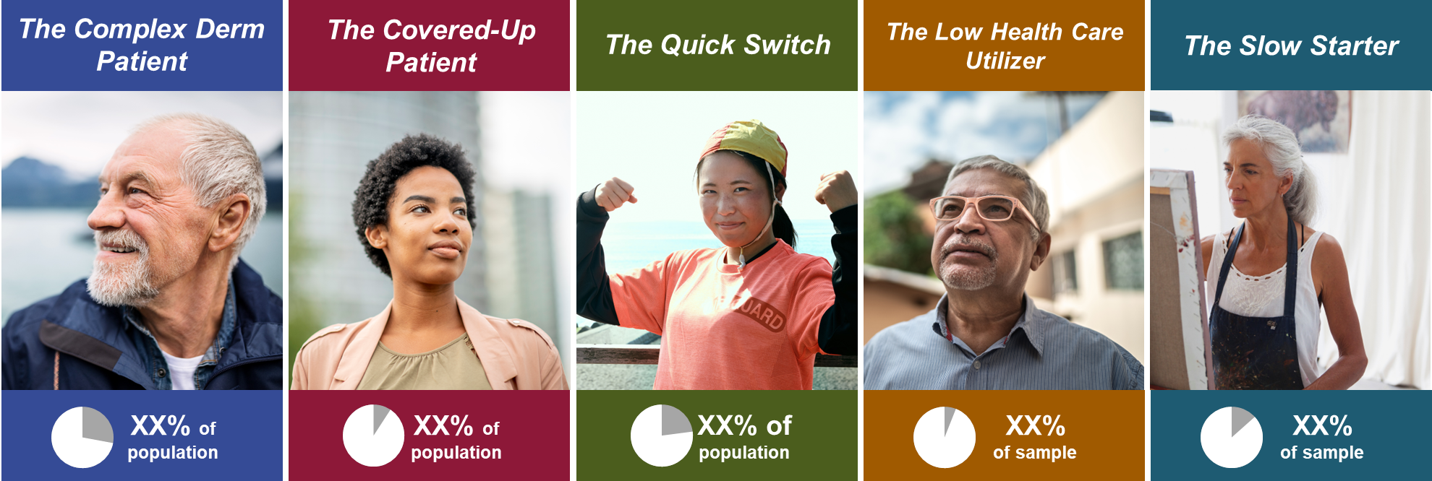

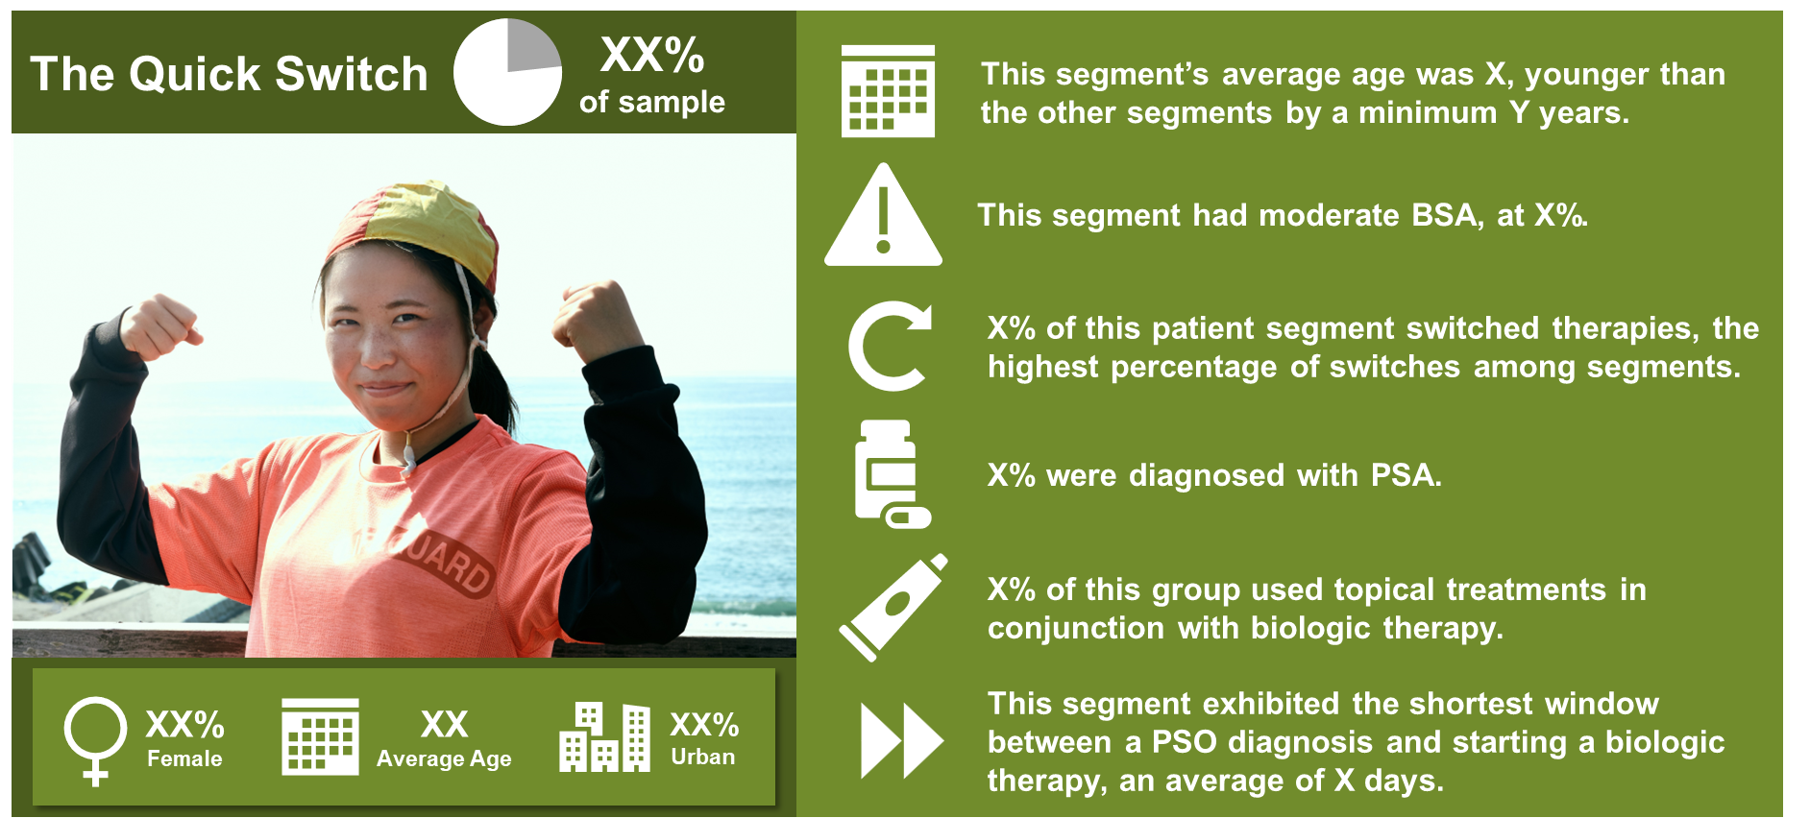

We have experience linking insights across Hub, claims, clinical, weather, and SDOH* data to enhance your orchestrated customer experience
ML-driven
Microsegmentation
Predictive Triggers
For Next Best Action
Alert a Bylvay Care Coordinator that a patient is high risk of PA denial.
Recommend a Sales Rep detail the Onc/Gastro treating a patient predicted to be diagnosed with carcinoid syndrome.
Tailor messaging based on the behaviors of HCPs and patients.
* Social Determinants of Health (SDOH)

Slide 8
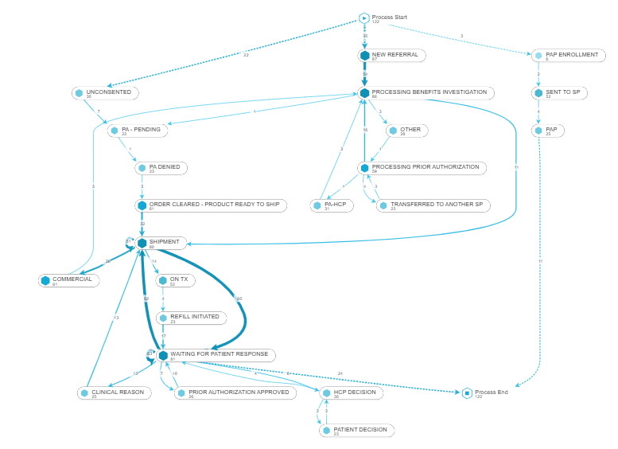
We can quickly create journeys from Hub and Specialty Pharma data to visually explore the path from referral to fulfillment
Allows the patient support teams to:
Understand the most common path that cases follow
Understand alternative paths to fulfillment or abandonment
Breakdown the steps in prior authorization
Identify and classify ways in which authorization is obtained

Slide 9
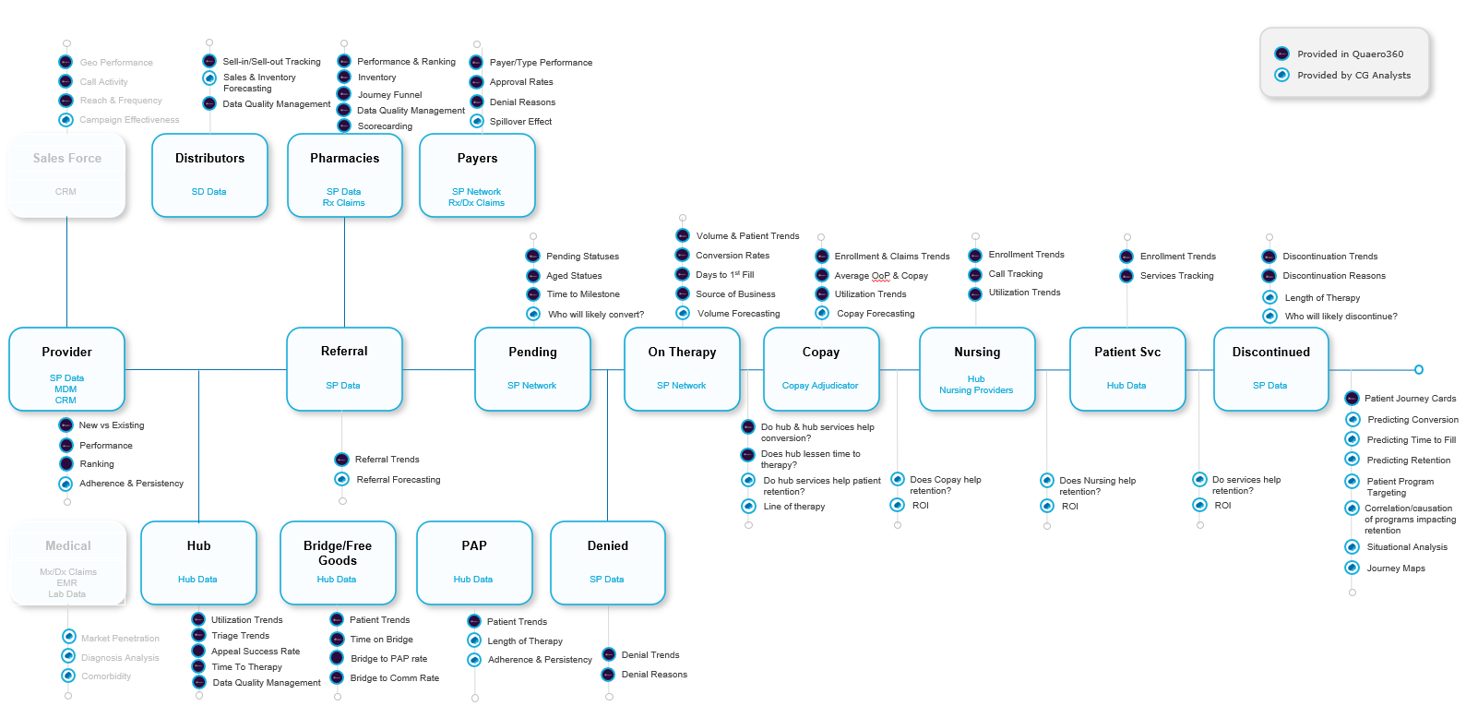
Typical KPIs across Patients’ Journey
Notes:
(1) https://www.novartis.com/news/media-releases/novartis-announces-fda-and-ema-filing-acceptance-ofatumumab-novel-b-cell-therapy-patients-relapsing-forms-multiple-sclerosis-rms

Slide 10

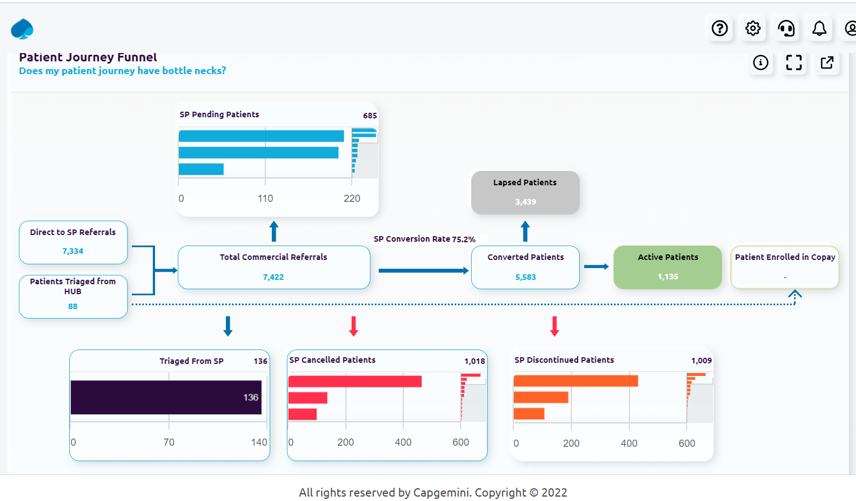
AGENTIC AI ENABLED INTERVENTIONS FOR INCREASED CONVERSION RATES
DATA DRIVEN INSIGHTS INTO PATIENT ACCESS BARRIERS
Transparency into real time patient journey pathway, identifying risks and milestone for therapeutic initiation and adherence. Patient access teams, ARMs, prescribers, office staff, and patients outreach with micro targeted messaging campaigns to drive pull through.
Real Time Patient Intervention Opportunities
Leverage specialty pharmacy and Hub patient status data to identify HCP and Payer specific barriers to therapeutic initiation and adherence
Adopt a "Next Best Action" approach to triage stalled patient scripts with HCPs
HCPs, ARMs, and Office Staff will have full transparency into the patient journey with the specific goal of reducing therapeutic initiation (time to first fill and conversion rates) and therapeutic adherence (PDC, MPR) with precise diagnoses and targeted messaging
Quick follow up during BV/PA phase as patient services teams now have insights into new and pending patient payor profiles (BIN, PNC, GRP)
ARMs have access to relevant data to inform HCPs
Adopt data-driven business models to drive HCP satisfaction post successful conversion

Slide 11
AGENTIC AI ENABLED INTERVENTIONS FOR INCREASED ADHERENCE RATES
DATA DRIVEN INSIGHTS INTO DRIVERS OF THERAPEUTIC ABANDONMENT
Leverage ML/AI and data driven insights to identify "lapsed patients" - those at highest risk of gaps in therapy or cancellation/discontinuation. Micro-targeted messaging directed at patients/caregivers, HCPs, ARMs, Hubs, Office Staff can drive better healthcare outcomes by keeping patients on therapy longer.
Proactively Identify Patients At Risk of Gaps in Therapy or Abandonment
Use data driven insights (SP, Hub, SDOH, Lab) to identify drivers of patient behaviors as it pertains to therapeutic adherence
Adopt a "precise medicine" approach to create patient level communication pathways designed to increase therapeutic compliance
HCPs, ARMs, and Office Staff will have full transparency into the patient journey with the specific goal of increasing therapeutic adherence (PDC, MPR) with precise diagnoses and targeted messaging
Triage to Hub
Ways to reduce patient out of pocket
Availability of and consent into patient engagement/intervention programs

